Slide 1

RNS INSTITUTE OF TECHNOLOGY
BENGALURU - 98
DEPARTMENT OF INFORMATION SCIENCE & ENGINEERING
Presentation on Internship
Predict The Price Of Books
Vaishnavi S M
USN: 1RN18IS115
LocalHost Technology Private Limited
Internal Guide
Mrs. Shwetha G N
Asst. Prof, Dept of ISE, RNSIT
External Guide
Mr. Satyendra Nath ,
Data Scientist,
LocalHost Technology
Notes:
1

Slide 2
AGENDA
Abstract
About the Company
Introduction
Literature Survey
Requirements
System Design
Detailed Design
Implementation
Testing
Conclusion and Future Enhancements
References
Q & A
VII Semester, Department of ISE, RNSIT
2021 - 2022
2

Slide 3
ABSTRACT
The so-called paradoxes of an author, to which a reader takes exception, often exist not in the author’s book at all, but rather in the reader’s head.
– Friedrich Nietzsche
Books are open doors to an unimagined world which is unique to every person. It is more than just a hobby for many. There are many among us who prefer to spend more time with books than anything else.
Here we explore a big database of books. Books of different genres, from thousands of authors. In this project, we were required to use the dataset to build a Machine Learning model to predict the price of books based on a given set of features.
VII Semester, Department of ISE, RNSIT
2021 - 2022
2

Slide 4
About the Company
Localhost Technology Private Limited is an unlisted private company incorporated on 16 October, 2018. It is classified as a private limited company and is located in Patna, Bihar. It's authorized share capital is INR 1.00 lac and the total paid-up capital is INR 1.00 lac.
The last reported AGM (Annual General Meeting) of Localhost Technology Private Limited, per our records, was held on 30 September, 2019. Also, as per our records, its last balance sheet was prepared for the period ending on 31 March, 2019.
VII Semester, Department of ISE, RNSIT
2021 - 2022
4

Slide 5
INTRODUCTION
Data science is the field of data analytics and data visualization in which raw data or the unstructured data is cleaned and made ready for the analysis purpose.
In this project we use the given data set to predict the price of books based on certain features like:
Title: The title of the book
Author: The author(s) of the book.
Edition: The edition of the book
Reviews: The customer reviews about the book
Ratings: The customer ratings of the book
Synopsis: The synopsis of the book
Genre: The genre the book belongs to
Book Category: The department the book is usually available at.
Price: The price of the book (Target variable)
VII Semester, Department of ISE, RNSIT
2021 - 2022
5

Slide 6
LITERATURE SURVEY
A literature review is an overview of the previously published works on a specific topic. The term can refer to a full scholarly paper or a section of a scholarly work such as a book, or an article.
MACHINE LEARNING BASED TECHNIQUES IN MEDICAL DATA ANALYSIS by Lavanya Vemulapalli and Dr. P. Chandra Sekhar.
Machine hack website:
https://www.kaggle.com/anmolkumar/machine-hack-book-price-prediction
Basic Data Science projects from:
https://www.interviewbit.com/blog/data-science-projects/
VIII Semester, Department of ISE, RNSIT
2021 - 2022
6

Slide 7
REQUIREMENTS
Anaconda Navigator
Jupyter Notebook
Data Set(TEST and TRAIN DATA)
VIII Semester, Department of ISE, RNSIT
2021 - 2022
7

Slide 8
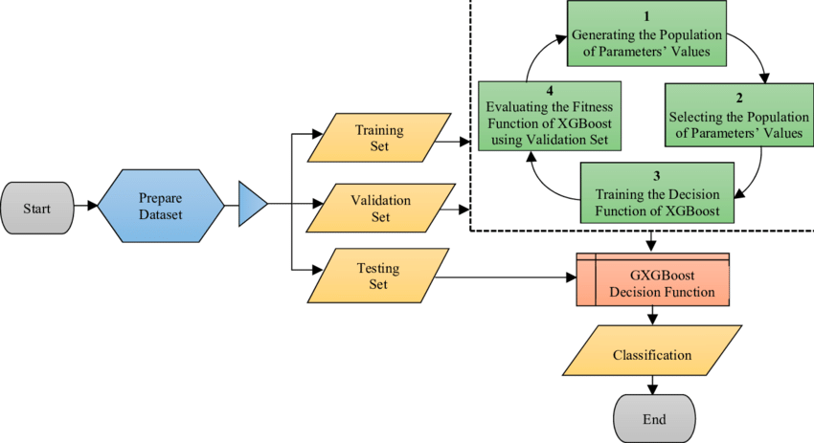
SYSTEM DESIGN
The flowchart of the Xgboost algorithm
VII Semester, Department of ISE, RNSIT
2021 - 2022
7
Notes:
8

Slide 9
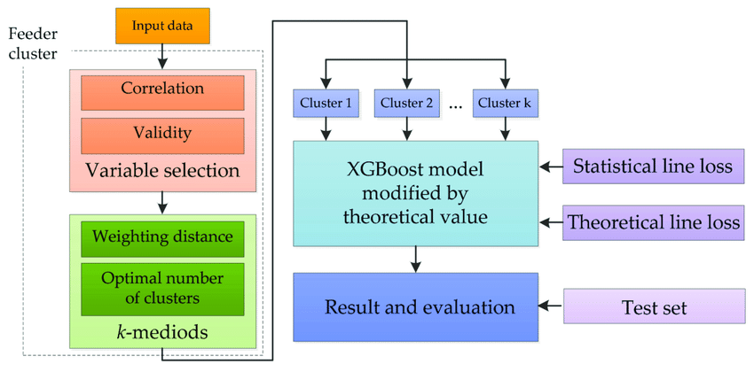
DETAILED DESIGN
This figure shows the basic XGboost algorithm
VIII Semester, Department of ISE, RNSIT
2021 - 2022
9
Notes:
9

Slide 10
Implementation / Coding
from xgboost import XGBRegressor
import numpy as np
xgb=XGBRegressor( objective='reg:squarederror', max_depth=6, learning_rate=0.1, n_estimators=100, booster = 'gbtree', n_jobs = -1,random_state = 1)
xgb.fit(train_x,train_y)
y_pred = sc.inverse_transform(xgb.predict(val_x))
y_true = sc.inverse_transform(val_y)
error = np.square(np.log10(y_pred +1) - np.log10(y_true +1)).mean() ** 0.5
score = 1 – error
print("RMLSE Score = ", score)
VIII Semester, Department of ISE, RNSIT
2021 - 2022
10
Notes:
10

Slide 11
CONCLUSIONS
XGboost is an optimized distributed gradient boosting library designed to be highly efficient, flexible and portable.
This project can be used to predict the price of books with the help of XGboost algorithm in the field of Data Science and in the later stages, its accuracy can be increased eventually.
All in all the project is very helpful and makes use of Machine Learning with Data Science to give us the required outputs.
VIII Semester, Department of ISE, RNSIT
2021 - 2022
11
Notes:
11

Slide 12
Future Enhancements
We can further increase the efficiency of the algorithm.
Improve the accuracy of prediction.
Try to decrease the execution time.
VII Semester, Department of ISE, RNSIT
2021 - 2022
12
Notes:
12

Slide 13
REFERENCES
[1] Machine hack website:
https://machinehack.com/hackathon/predict_the_price_of_books/overview
[2] https://medium.com/analytics-vidhya/books-price-prediction-via-python-31dc358ad8d8
[3] Paper on: LITERATURE SURVEY ON MACHINE LEARNING BASED TECHNIQUES IN MEDICAL DATA ANALYSIS by Lavanya Vemulapalli and Dr. P. Chandra Sekhar
VIII Semester, Department of ISE, RNSIT
2021 - 2022
13

Slide 14
THANK YOU
VIII Semester, Department of ISE, RNSIT
2021 - 2022
14

